Slide 1
Filters (Bloom, Quotient, & Cuckoo)
CSCI 333

Slide 2
Bloom Filters
Are there any problems with Bloom filters?
  What operations do they support/not support?
  How do you grow a Bloom filter?
  What if your filter itself exceeds RAM (how bad is locality)?

Slide 3
Quotient Filters
Based on a technique from a homework question in Donald Knuth’s “The Art of Computer Programming: Sorting and Searching, volume 3” (Section 6.4, exercise 13)
Quotienting Idea:
Hash:
1 0 1 1 0 0 1 0 1 1 0 1 1 1 0 0 1 0 1

Slide 4
Quotient Filters
Based on a technique from a homework question in Donald Knuth’s “The Art of Computer Programming: Sorting and Searching, volume 3” (Section 6.4, exercise 13)
Quotienting Idea:
Remaining bits are discarded/lost
Hash:
1 0 1 1 0 0 1 0 1 1 0 1 1 1 0 0 1 0 1
Quotient: q most significant bits
Remainder: r least significant bits

Slide 5
Building a Quotient Filter
The quotient is used as an index into an m-bucket array, where the remainder is stored.
  Essentially, a hashtable that stores the remainders as a value
Collisions are resolved using linear probing and 3 extra bits per bucket
  is_occupied: whether a slot is the canonical slot for some value currently stored in the filter
  is_continuation: whether a slot holds a remainder that is part of a run (but not the first)
  is_shifted: whether a slot holds a remainder that is not in its canonical slot

Slide 6
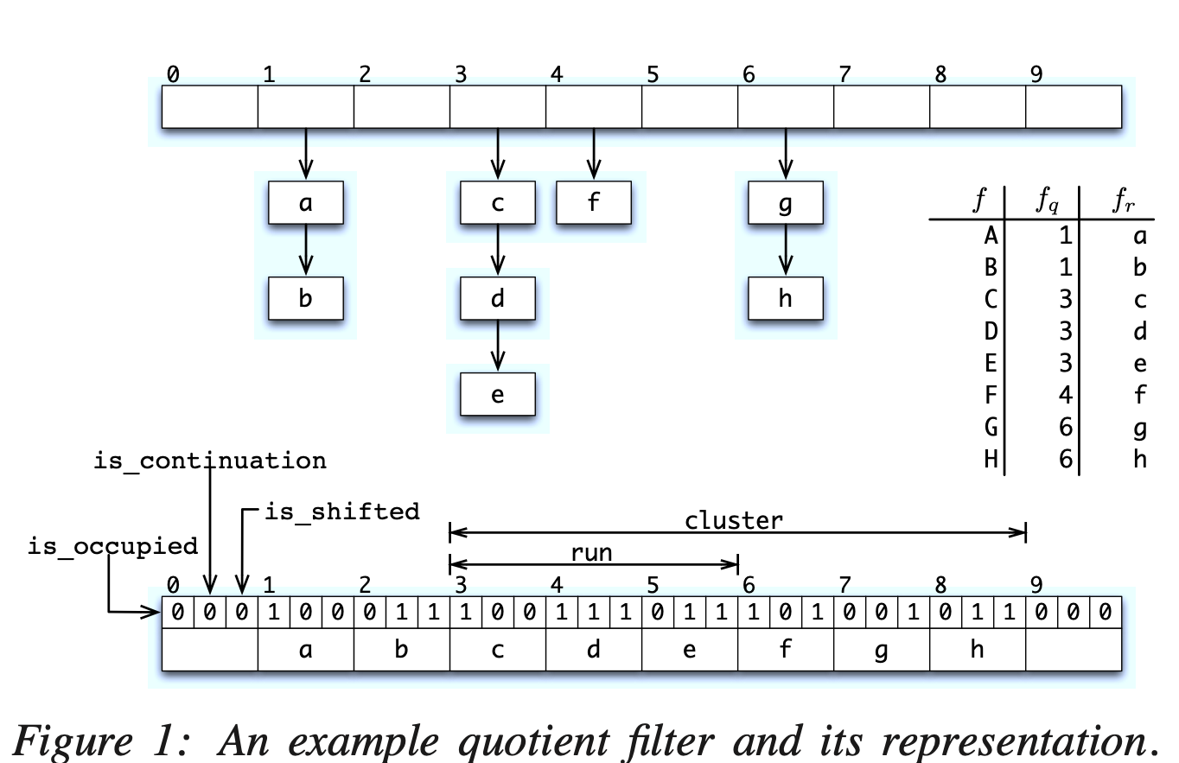
Quotient Filter Example
Table of objects with quotients/ remainders for reference
Hash table with external chaining
Hash table with linear probing + bits
[https://www.usenix.org/conference/hotstorage11/dont-thrash-how-cache-your-hash-flash]

Slide 7
Quotient Filter Example
[https://www.usenix.org/conference/hotstorage11/dont-thrash-how-cache-your-hash-flash]

Slide 8
Quotient Filter Concept-check
What are the possible reasons for a collision?
  Which collisions are treated as “false positives”
What parameters does the QF give the user? In other words:
  What knobs can you turn to control the size of the filter?
  What knobs can you turn to control the false positive rate of the filter?

Slide 9
Why QF over BF?
Supports deletes
Supports “merges”
Good cache locality
  How many locations accessed per operation?
  Some math can show that runs/clusters are expected to be small
Don’t Thrash, How to Cache Your Hash on Flash also introduces the Cascade filter, a write-optimized filter made up of increasingly large QFs that spill over to disk.
  Similar idea to Log-structured merge trees, which we will discuss soon!

Slide 10
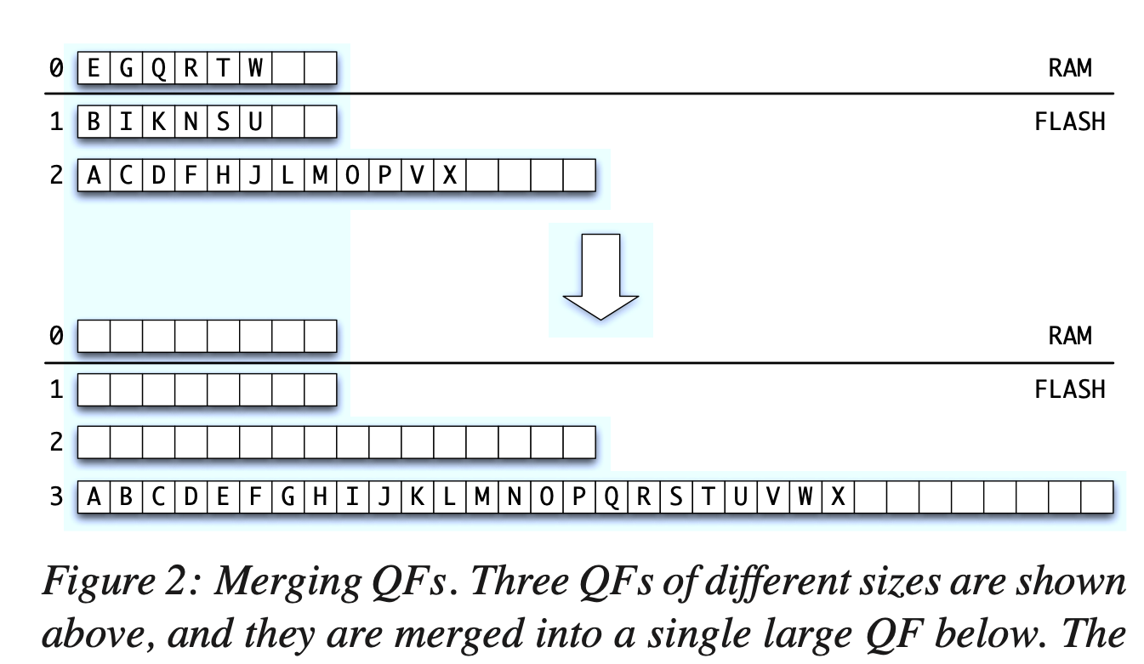
Cascade Filter
[https://www.usenix.org/conference/hotstorage11/dont-thrash-how-cache-your-hash-flash]

