Slide 1
Networking Panel
Jeannie Albrecht
  Williams College, Plush/Gush project
Ivan Seskar
  Rutgers University, WINLAB/ORBIT project
Steven Schwab
  Cobham Analytic Solutions, DETER project
Eric Eide
  University of Utah, Emulab project

Slide 2

Achieving Experiment Repeatability on PlanetLab
Jeannie Albrecht
jeannie@cs.williams.edu
Williams College

Slide 3
Overview
Archiving experiments on wide-area testbeds requires the ability to capture (i.e., measure and record):
  Network conditions (bandwidth, latency, etc)
  Machine properties (CPU usage, free memory, etc)
  Experiment characteristics (software/OS versions, etc)
Repeating experiments on wide-area testbeds requires the ability to configure these same properties
How can we achieve these goals on wide-area testbeds?

Slide 4


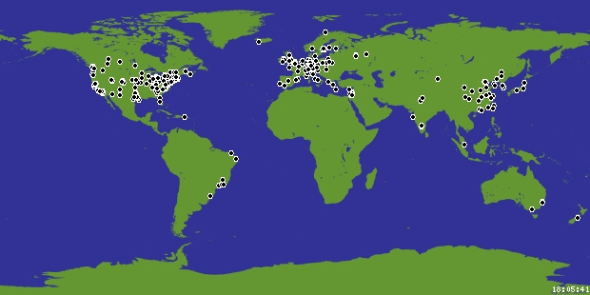
Network of 1000+ Linux machines at 500+ sites in 25+ countries
Allows researchers to run experiments “in the wild” (i.e., on machines spread around the world connected via “normal” Internet links)
  Each user gets an “account” (called a sliver) on each machine
  Resources are “allocated” via a proportional fair share scheduler
Volatile network
  High contention for machines leads to high failure rates near deadlines
  Common problems: low disk space, clock skew, connection refused
  In April 2006, only 394/599 machines were actually usable

Slide 5
Experimenter Tools
Many tools exist/have existed for coping with unpredictability of PlanetLab
  Monitoring services – measure machine/network usage in real-time
    CoMon (http://comon.cs.princeton.edu/status/),
    S³ (http://networking.hpl.hp.com/s-cube/),
    Ganglia, iPerf, all-pairs-ping, Trumpet
  Resource discovery – find machines that meet specific criteria
    Sword (http://sword.cs.williams.edu)
  Experiment management – simplify/automate tasks associated with running experiments
    Gush/Plush (http://gush.cs.williams.edu),
    appmanager (http://appmanager.berkeley.intel-research.net/)

Slide 6
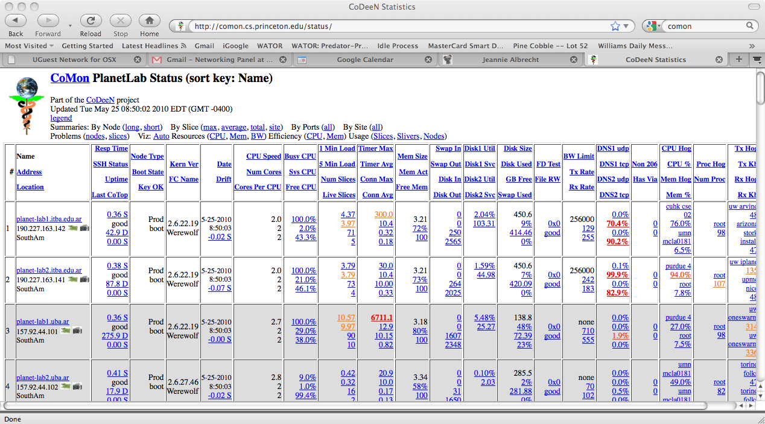
CoMon: Node Monitoring

Slide 7
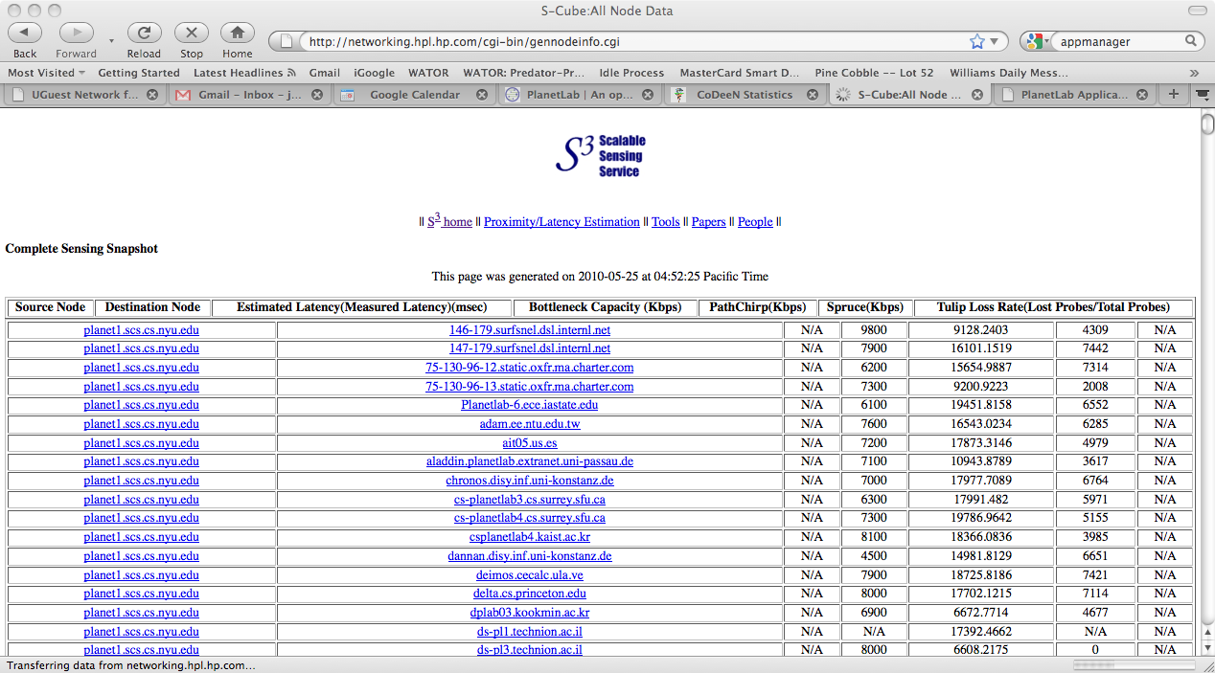
S³: Network Monitoring

Slide 8
SWORD:
Resource Discovery
Node4
Node1
Node2
Node3
Node8
Node5
Node7
Node6
Node11
Node9
Node10
PlanetLab
CoMon+S³ data
SWORD
(ii)
Logical Database &
Query Processor
Node5
Node4
Node3
(iii)
Matcher &
Optimizer
Node4
Group 1
(i)
Query
Node2
Node7
No5e6
Node6
Group 2
Node6
Candidate nodes
XML
Optimal resource groups
Node5
Node4
Node2
Node7
Node6
Group 1
Group 2

Slide 9
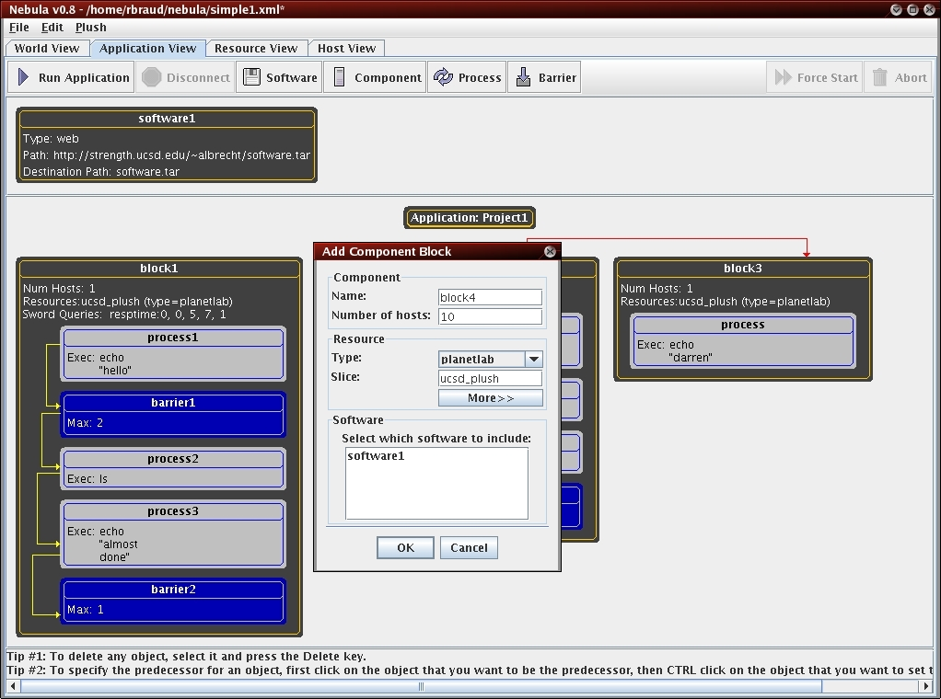
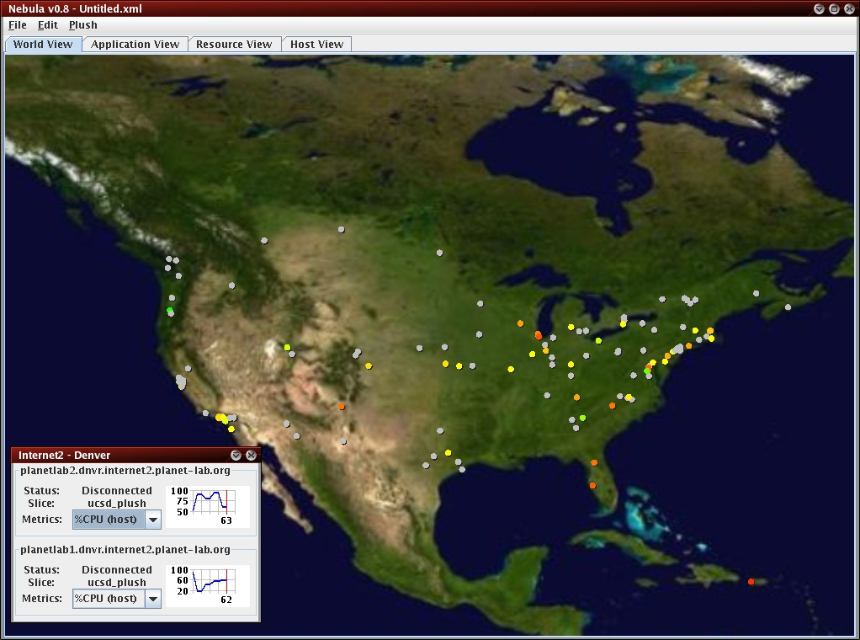
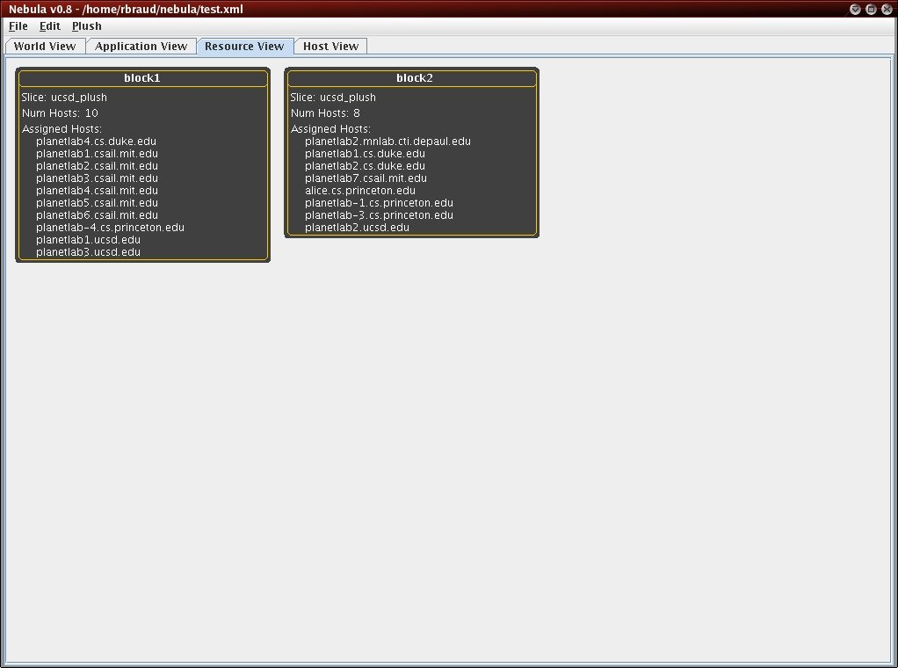
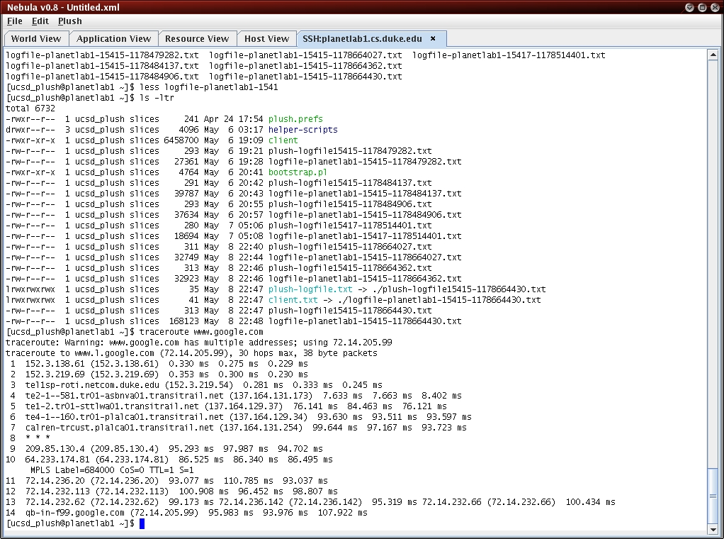
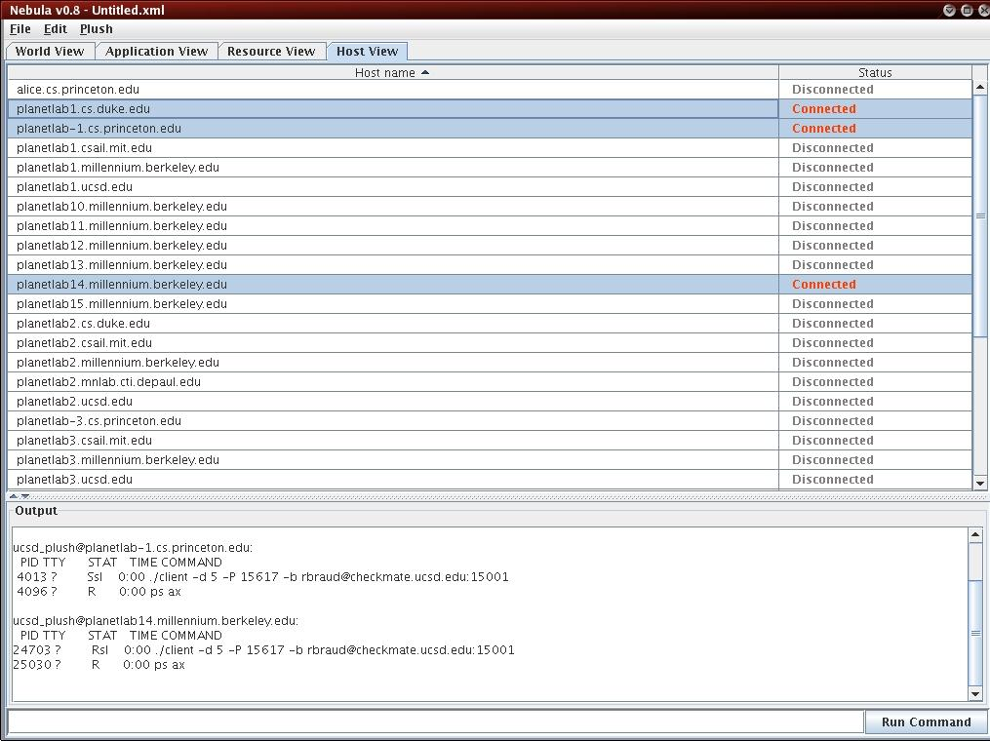
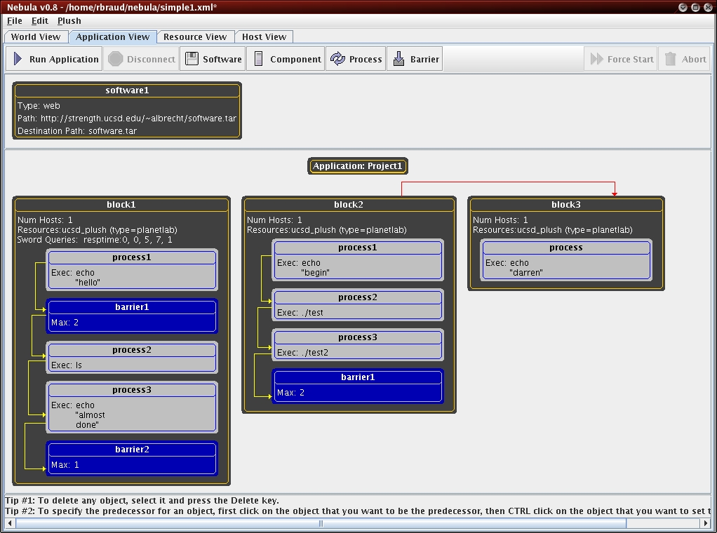
Gush: Experiment Management
Allows users to describe, run, monitor, & visualize experiments
XML-RPC interface for managing experiments programmatically

Slide 10
Capturing Live Conditions
Machine properties
  CoMon is a centrally run service that satisfies this requirement
Experiment characteristics
  Gush records information about software versions and machines used for experiment
Network conditions
  S³ mostly meets these requirements
  Other services have existed in the past—now mostly offline!
  S³ is difficult to query (lacks “sensor” interface) and is only updated every 4 hours

Slide 11
Experiment Configuration
Machine properties
  No resource isolation in PlanetLab
  Cannot specify machine properties
Experiment characteristics
  Experiment management and resource discovery tools can help with this
  Cannot control OS version
Network conditions
  Currently no way to specify underlying network topology characteristics

Slide 12
Possible Solutions
Create a reliable network measurement service (similar to S³+CoMon)!
Capture conditions in initial experiment; monitor live conditions until they “match” and then start experiment
Provide stronger resource isolation on PlanetLab (Vini?)
Use captured conditions to replay experiment in more controllable environment (Emulab, ORCA, etc)

Slide 13
Food For Thought
Experiment archival on PlanetLab is difficult but can (almost) be accomplished
Experiment repeatability is mostly impossible
  But is this necessarily bad?
  What does it mean for an experiment to be repeatable?
  Do all testbeds have to enable fully repeatable experiments?
Does archival imply repeatability? Are both required?
Some volatility/unpredictability is arguably a good thing (more “realistic”)
  Internet does not provide repeatability!
Perhaps best approach is to use a combination of configurable and non-configurable testbeds
  Simulation/emulation + live deployment
  Best of both worlds?

Slide 14
Thanks!

